Slide 1
Chapter 1

Slide 2
User
Interface
Implementation
Operations

Slide 3
n
sqrt()
Square root of n

Slide 4
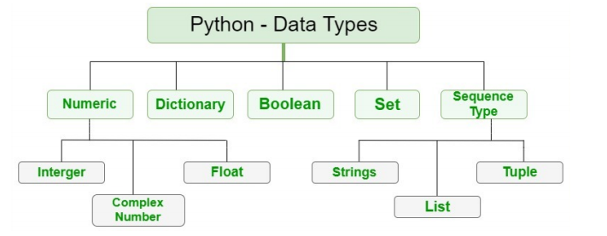

Slide 5
Python Data Types
Boolean
Numeric
Sequence
Dictionary
Set
bool
int
str
dict
set
float
list
frozenset
complex
tuple
range

Slide 6
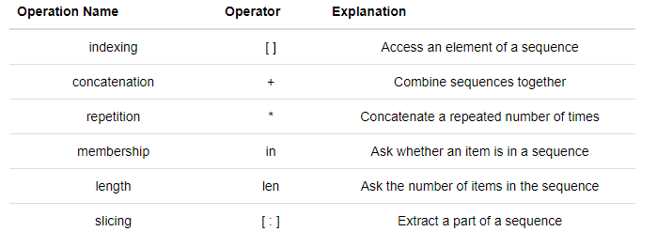

Slide 7
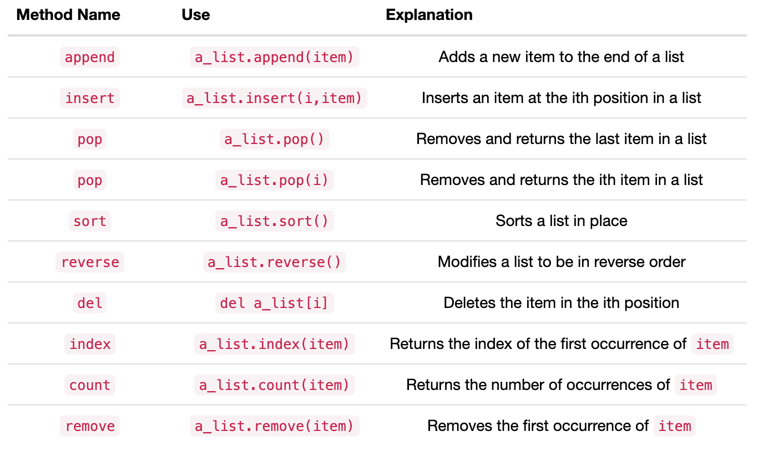

Slide 8
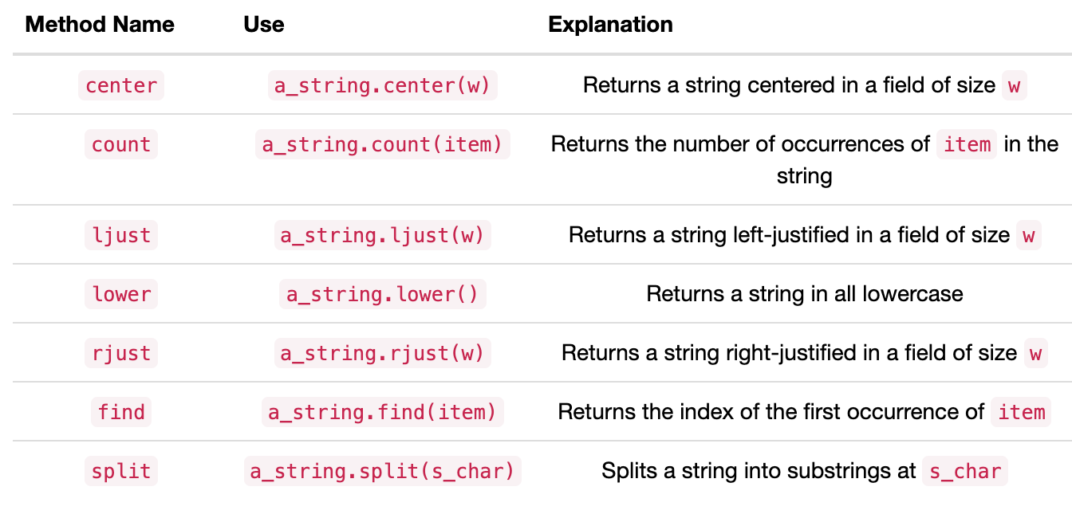

Slide 9
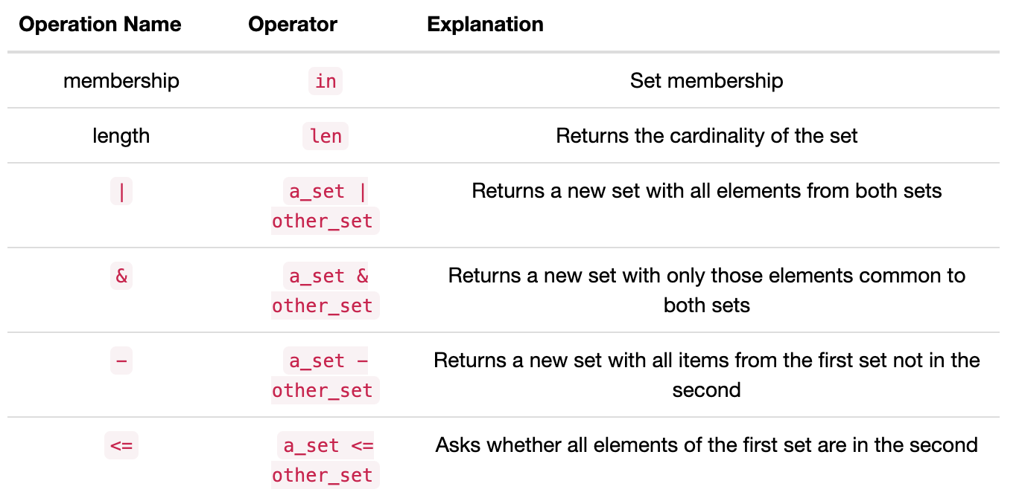

Slide 10
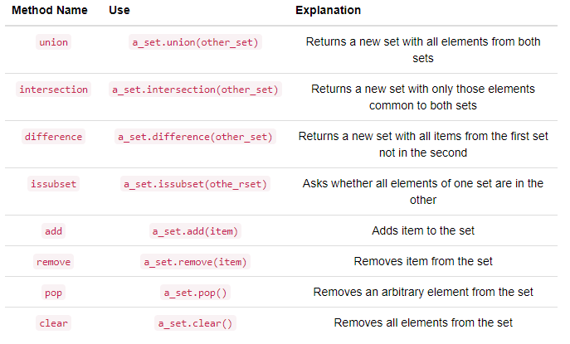

Slide 11
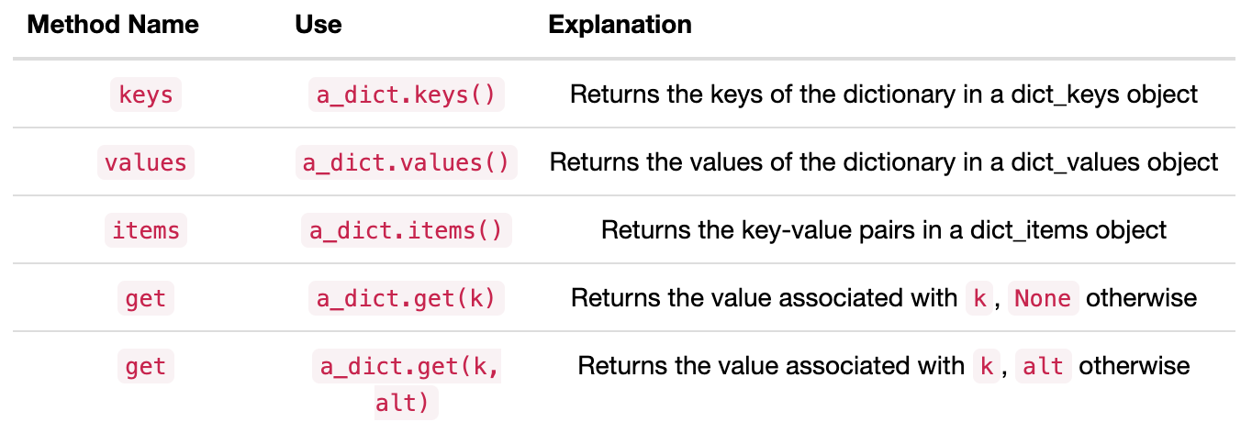

Slide 12
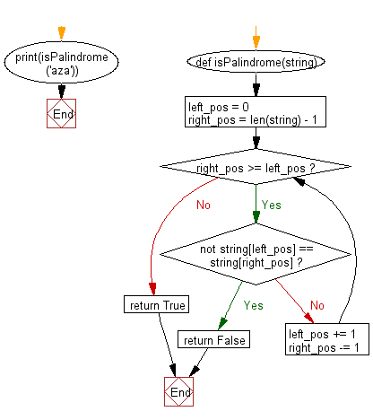

Slide 13
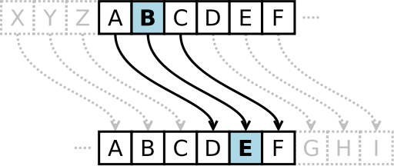

Slide 14
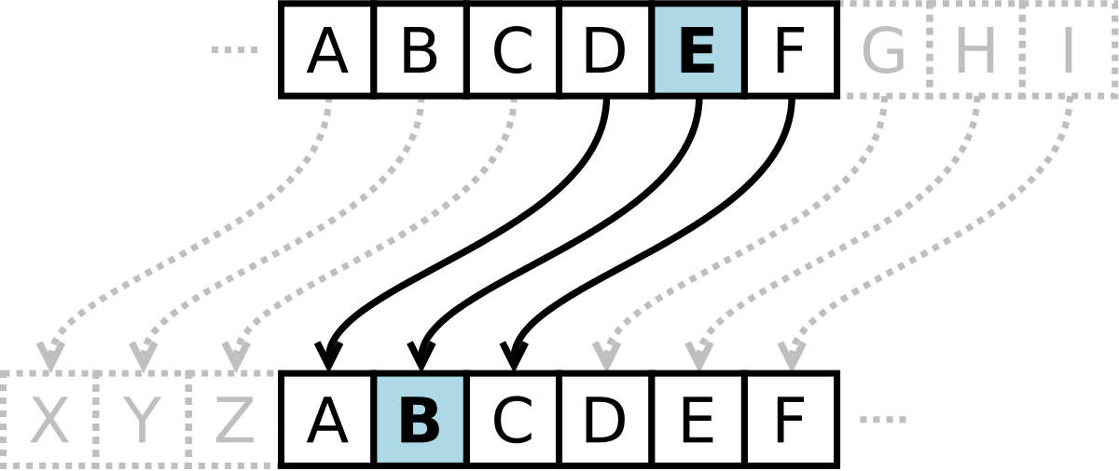

Slide 15
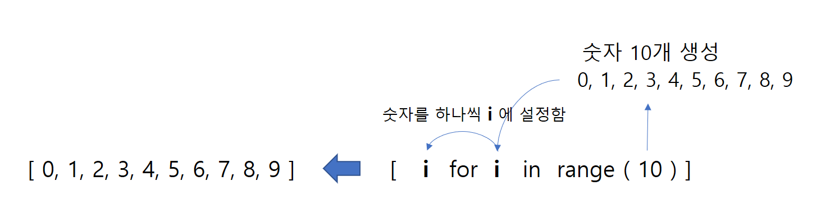

Slide 16
Methods
num
my_fraction
3
State
den
5

Slide 17
Shallow Equality
Methods
f1
num
3
State
den
f2
5
str
add
Methods
Deep Equality
Methods
f1
num
3
num
State
den
3
5
State
str
add
den
f2
5
str
add

Slide 18
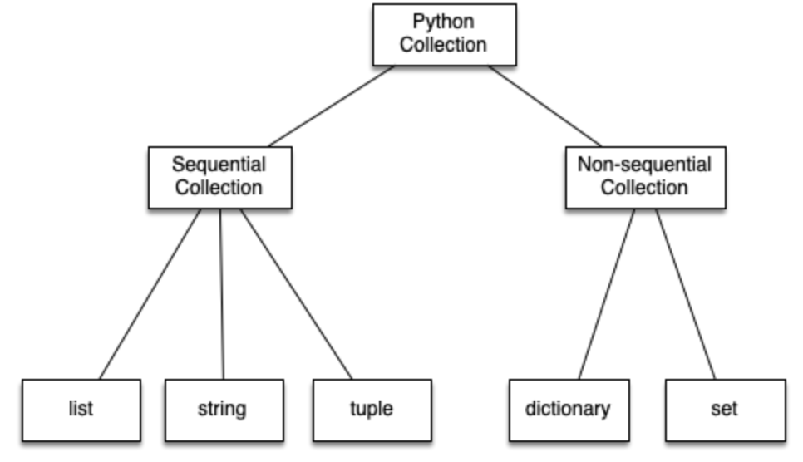

Slide 19
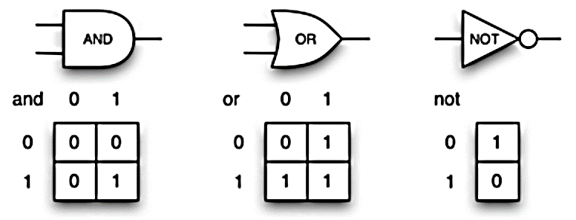

Slide 20
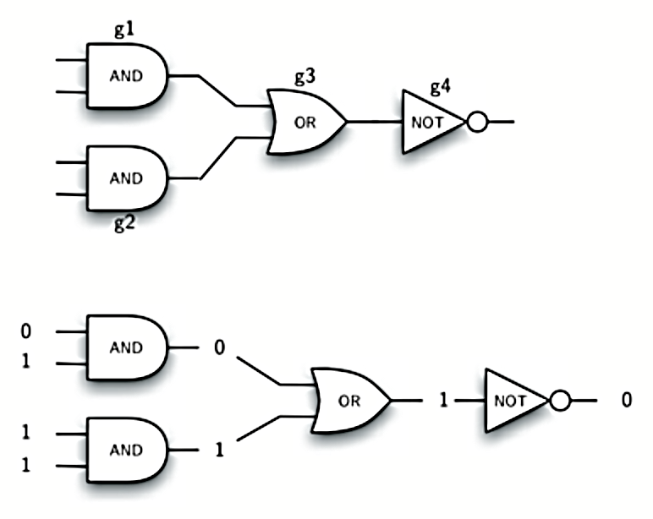

Slide 21
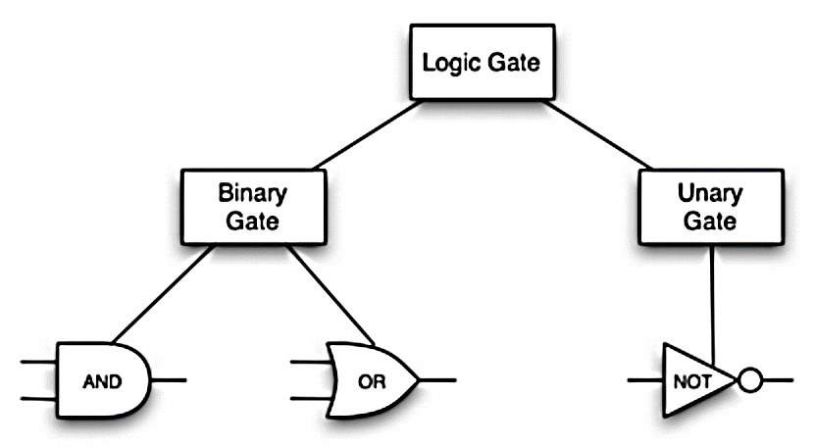

Slide 22
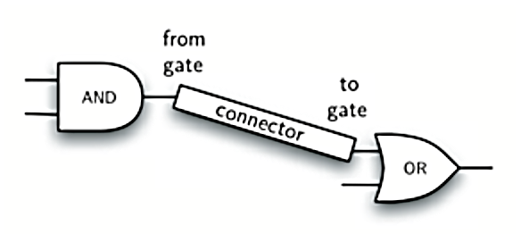

Slide 23
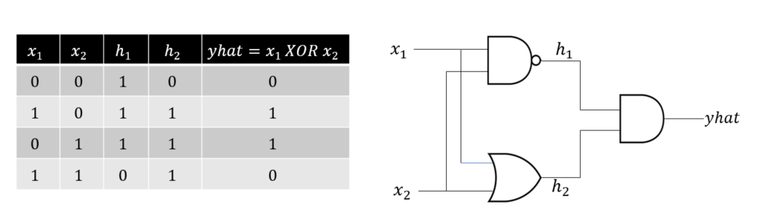

Slide 24
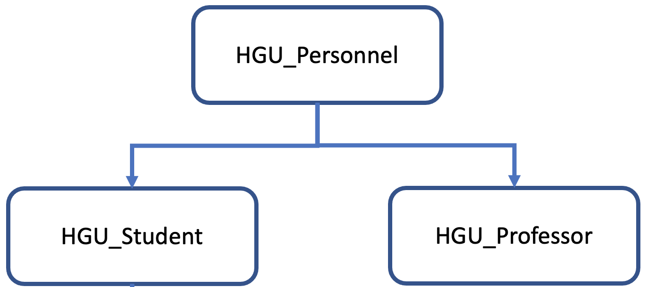

Slide 25
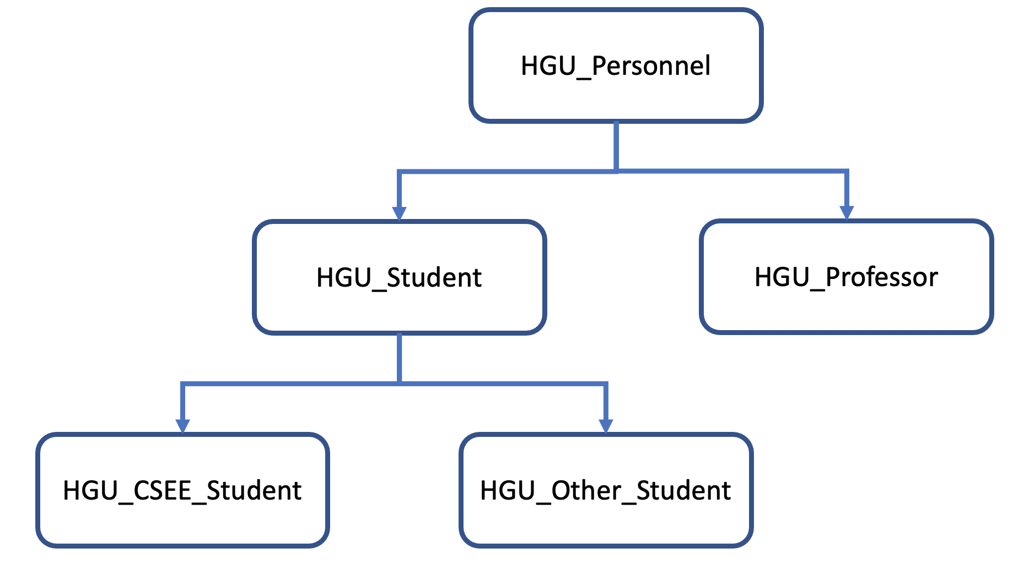

Slide 26
Python JSON Parsing:
Decode JSON using load() & loads()
json.load()
json.loads()
JSON File
students.json
String
{"name": "Joe", "id":20}
JSON String
'{"name": "Joe", "id":20}'
json.load(fileHandle)
json.loads(json String)
{ "name": "Joe", "id":20 }
{ "name": "Joe", "id":20 }
Python Dictionary
Python Dictionary

Slide 27
Python JSON Encoding:
Encode JSON using dump() & dumps()
json.dump()
json.dumps()
{ "name": "Joe", "id":20 }
{ "name": "Joe", "id":20 }
Python Dictionary
Python Dictionary
json.dump(file,PythonDictionary)
json.dumps(PythonDictionary)
JSON File
students.json
'{ "name": "Joe", "id":20 }'
{ "name": "Joe", "id":20 }
Python str, JSON String type

Slide 28

Welcome to "Data Structures in Python"
Lecture Notes by idebtor@gmail.com, Handong Global University
Markdown Tutorial
by idebtor@gmail.com, Handong Global University

